Slide 1




My Algebra Interactive Notebook
$$3ab$$
$$2x+3y$$
$$\frac{5xy}{6}$$
Name :
Class :
Term 2 Semester 1
$$y=2x+1$$

Slide 2
Set or hook
Remember this question from your first
Mini Test?
21b⁸ / 6b³

Slide 3
Contents
Glossary
Page
Date
Description
2
3

Slide 4
Tasks
24
7
30
Essential Question
Questions
Notes
Summary
4
7

Slide 5
24
7
30
Date
Simplifying Expressions
EQ – How do I simplify if the terms are divided?

Slide 6

24
7
30
Date
Simplifying Expressions
EQ – How do I simplify if the terms are divided?
What happens to the $÷$ sign?

Slide 7
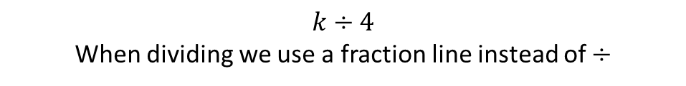
24
7
30
Date
Simplifying Expressions
EQ – How do I simplify if the terms are divided?
$$k÷4$$
When dividing we use a fraction line instead of $÷$
What happens to the $÷$ sign?

Slide 8
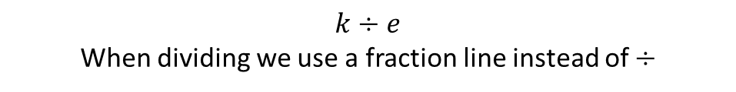
24
7
30
Date
Simplifying Expressions
EQ – How do I simplify if the terms are divided?
$$k÷e$$
When dividing we use a fraction line instead of $÷$
What happens to the $÷$ sign?
Thus: $= \frac{k}{4}$

Slide 9
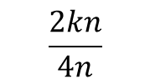
24
7
30
Date
Simplifying Expressions
EQ – How do I simplify if the terms are divided?
$$k÷e$$
When dividing we use a fraction line instead of $÷$
What happens to the $÷$ sign?
Thus: $= \frac{k}{4}$
Examples:
$$\frac{2kn}{4n}$$

Slide 10
24
7
30
Date
Simplifying Expressions
EQ – How do I simplify if the terms are divided?
$$k÷e$$
When dividing we use a fraction line instead of $÷$
What happens to the $÷$ sign?
Thus: $= \frac{k}{4}$
Examples:
Divide by 2
$$\frac{2kn}{4n}$$

Slide 11


24
7
30
Date
Simplifying Expressions
EQ – How do I simplify if the terms are divided?
$$k÷e$$
When dividing we use a fraction line instead of $÷$
What happens to the $÷$ sign?
Thus: $= \frac{k}{4}$
Examples:
Divide by 2
$$÷2$$
$$\frac{2kn}{4n}$$
$$÷2$$

Slide 12
24
7
30
Date
Simplifying Expressions
EQ – How do I simplify if the terms are divided?
$$k÷e$$
When dividing we use a fraction line instead of $÷$
What happens to the $÷$ sign?
Thus: $= \frac{k}{4}$
1
Examples:
Divide by 2
$$÷2$$
$$\frac{2kn}{4n}$$
$$÷2$$
2

Slide 13
24
7
30
Date
Simplifying Expressions
EQ – How do I simplify if the terms are divided?
$$k÷e$$
When dividing we use a fraction line instead of $÷$
What happens to the $÷$ sign?
Thus: $= \frac{k}{4}$
1
Examples:
Divide by 2
$$÷2$$
$$\frac{2kn}{4n}$$
Cancel out
$$÷2$$
2

Slide 14


24
7
30
Date
Simplifying Expressions
EQ – How do I simplify if the terms are divided?
$$k÷e$$
When dividing we use a fraction line instead of $÷$
What happens to the $÷$ sign?
Thus: $= \frac{k}{4}$
1
Examples:
$$÷2$$
$$÷n$$
Divide by 2
$$\frac{2kn}{4n}$$
Cancel out
$$÷2$$
$$÷n$$
2

Slide 15
24
7
30
Date
Simplifying Expressions
EQ – How do I simplify if the terms are divided?
$$k÷e$$
When dividing we use a fraction line instead of $÷$
What happens to the $÷$ sign?
Thus: $= \frac{k}{4}$
1
Examples:
$$÷2$$
$$÷n$$
Divide by 2
$$\frac{2kn}{4n}$$
Cancel out
$$÷2$$
$$÷n$$
2

Slide 16
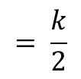
24
7
30
Date
Simplifying Expressions
EQ – How do I simplify if the terms are divided?
$$k÷e$$
When dividing we use a fraction line instead of $÷$
What happens to the $÷$ sign?
Thus: $= \frac{k}{4}$
1
Examples:
$$÷2$$
$$÷n$$
Divide by 2
$$\frac{2kn}{4n}$$
Cancel out
$$÷2$$
$$÷n$$
2
$$= \frac{k}{2}$$

Slide 17

24
7
30
Date
Simplifying Expressions
EQ – How do I simplify if the terms are divided?
$$k÷e$$
When dividing we use a fraction line instead of $÷$
What happens to the $÷$ sign?
Thus: $= \frac{k}{4}$
1
Examples:
$$÷2$$
$$÷n$$
Divide by 2
$$\frac{2kn}{4n}$$
Cancel out
$$÷2$$
$$÷n$$
2
$$= \frac{k}{2}$$
$$k means 1k$$
We don’t need to write the 1

Slide 18
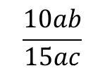
24
7
30
Date
Simplifying Expressions
EQ – How do I simplify if the terms are divided?
$$k÷e$$
When dividing we use a fraction line instead of $÷$
What happens to the $÷$ sign?
Thus: $= \frac{k}{4}$
1
Examples:
$$÷2$$
$$÷n$$
Divide by 2
$$\frac{2kn}{4n}$$
Cancel out
$$÷2$$
$$÷n$$
2
$$= \frac{k}{2}$$
$$k means 1k$$
We don’t need to write the 1
$$\frac{10ab}{15ac}$$

Slide 19


24
7
30
Date
Simplifying Expressions
EQ – How do I simplify if the terms are divided?
$$k÷e$$
When dividing we use a fraction line instead of $÷$
What happens to the $÷$ sign?
Thus: $= \frac{k}{4}$
1
Examples:
$$÷2$$
$$÷n$$
Divide by 2
$$\frac{2kn}{4n}$$
Cancel out
$$÷2$$
$$÷n$$
2
$$= \frac{k}{2}$$
$$k means 1k$$
We don’t need to write the 1
$$÷5$$
$$\frac{10ab}{15ac}$$
Divide by 5
$$÷5$$

Slide 20
24
7
30
Date
Simplifying Expressions
EQ – How do I simplify if the terms are divided?
$$k÷e$$
When dividing we use a fraction line instead of $÷$
What happens to the $÷$ sign?
Thus: $= \frac{k}{4}$
1
Examples:
$$÷2$$
$$÷n$$
Divide by 2
$$\frac{2kn}{4n}$$
Cancel out
$$÷2$$
$$÷n$$
2
$$= \frac{k}{2}$$
$$k means 1k$$
We don’t need to write the 1
2
$$÷5$$
$$\frac{10ab}{15ac}$$
Divide by 5
$$÷5$$
3

Slide 21
24
7
30
Date
Simplifying Expressions
EQ – How do I simplify if the terms are divided?
$$k÷e$$
When dividing we use a fraction line instead of $÷$
What happens to the $÷$ sign?
Thus: $= \frac{k}{4}$
1
Examples:
$$÷2$$
$$÷n$$
Divide by 2
$$\frac{2kn}{4n}$$
Cancel out
$$÷2$$
$$÷n$$
2
$$= \frac{k}{2}$$
$$k means 1k$$
We don’t need to write the 1
2
$$÷5$$
$$\frac{10ab}{15ac}$$
Cancel out
Divide by 5
$$÷5$$
3

Slide 22


24
7
30
Date
Simplifying Expressions
EQ – How do I simplify if the terms are divided?
$$k÷e$$
When dividing we use a fraction line instead of $÷$
What happens to the $÷$ sign?
Thus: $= \frac{k}{4}$
1
Examples:
$$÷2$$
$$÷n$$
Divide by 2
$$\frac{2kn}{4n}$$
Cancel out
$$÷2$$
$$÷n$$
2
$$= \frac{k}{2}$$
$$k means 1k$$
We don’t need to write the 1
2
$$÷5$$
$$\frac{10ab}{15ac}$$
$$÷a$$
Cancel out
Divide by 5
$$÷5$$
$$÷a$$
3

Slide 23
24
7
30
Date
Simplifying Expressions
EQ – How do I simplify if the terms are divided?
$$k÷e$$
When dividing we use a fraction line instead of $÷$
What happens to the $÷$ sign?
Thus: $= \frac{k}{4}$
1
Examples:
$$÷2$$
$$÷n$$
Divide by 2
$$\frac{2kn}{4n}$$
Cancel out
$$÷2$$
$$÷n$$
2
$$= \frac{k}{2}$$
$$k means 1k$$
We don’t need to write the 1
2
$$÷5$$
$$\frac{10ab}{15ac}$$
$$÷a$$
Cancel out
Divide by 5
$$÷5$$
$$÷a$$
3

Slide 24
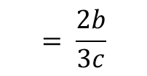
24
7
30
Date
Simplifying Expressions
EQ – How do I simplify if the terms are divided?
$$k÷e$$
When dividing we use a fraction line instead of $÷$
What happens to the $÷$ sign?
Thus: $= \frac{k}{4}$
1
Examples:
$$÷2$$
$$÷n$$
Divide by 2
$$\frac{2kn}{4n}$$
Cancel out
$$÷2$$
$$÷n$$
2
$$= \frac{k}{2}$$
$$k means 1k$$
We don’t need to write the 1
2
$$÷5$$
$$\frac{10ab}{15ac}$$
$$÷a$$
Cancel out
Divide by 5
$$÷5$$
$$÷a$$
3
$$= \frac{2b}{3c}$$

Slide 25
Let’s try these together
$$\frac{18x^{2}y}{8xz}$$

Slide 26
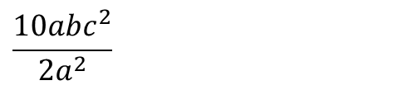
Let’s try these together
$$\frac{18x^{2}y}{8xz}$$
$$\frac{10abc^{2}}{2a^{2}}$$

Slide 27
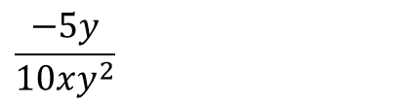
Let’s try these together
$$\frac{18x^{2}y}{8xz}$$
$$\frac{10abc^{2}}{2a^{2}}$$
$$\frac{−5y}{10xy^{2}}$$

Slide 28
Task
Enrichment:

Slide 29
Answers

Slide 30
Notes Review
24, 7 ,30
Date
Title
Essential question
Notes complete
Notes complete with colour and diagrams
Questions completed
Contents page filled in
Formula page filled in

Slide 31
Homework
Review your notes and write a summary answering the essential question.

